Slide 1

Employee Management System
Innomatics Research Labs Dilsukhnagar
Batch No : 403
Team:
Meduri V S Anand Bharadwaj
Melluri Vamshi Krishna Sharma
Ramesh Satta

Slide 2
PROJECT INTODUCTION
The Employee Management System (EMS) is designed to streamline the management of employee data, job roles, and departmental information within an organization. This system allows for efficient tracking of employee details
The system provides a centralized platform to store, retrieve, and update employee details such as employee information , job roles, departmental assignments, payroll, qualifications, and leave records.

Slide 3
TABLE STRUCTURE
There are six tables in the database as follows:
Job Department
Salary/Bonus
Employee
Qualification
Leaves
Payroll

Slide 4
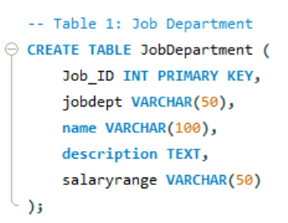
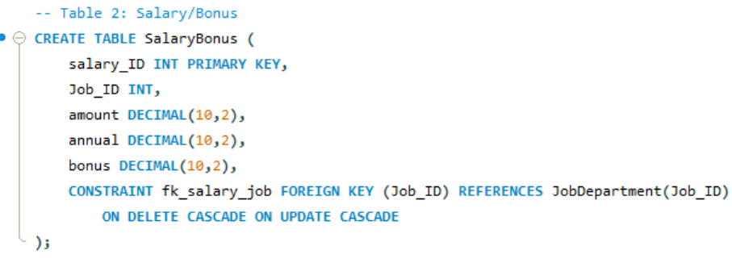
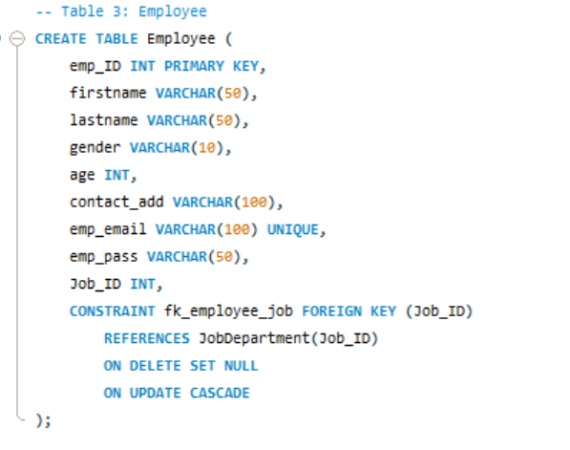

Slide 5
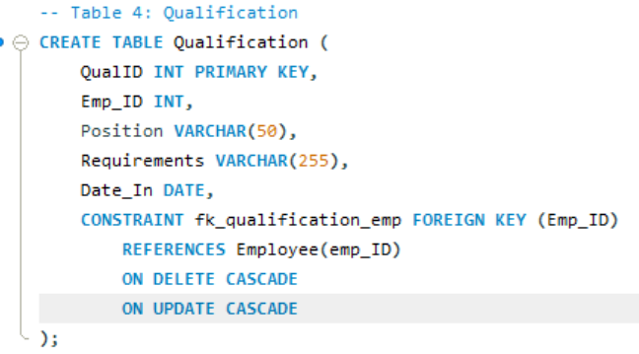
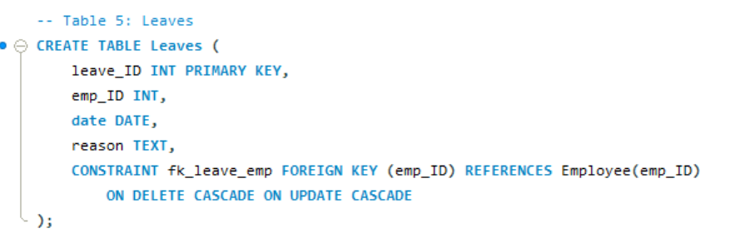

Slide 6
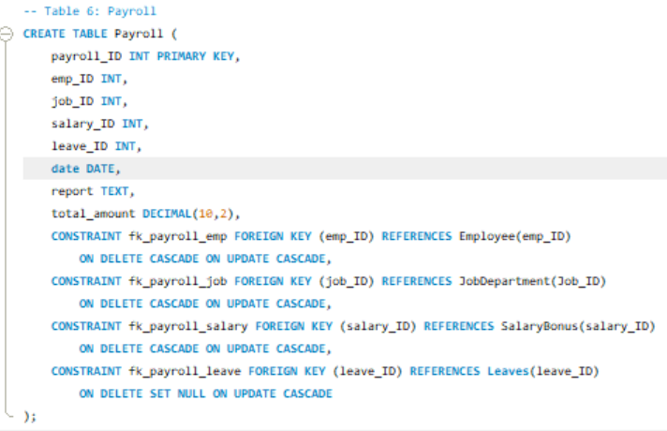

Slide 7
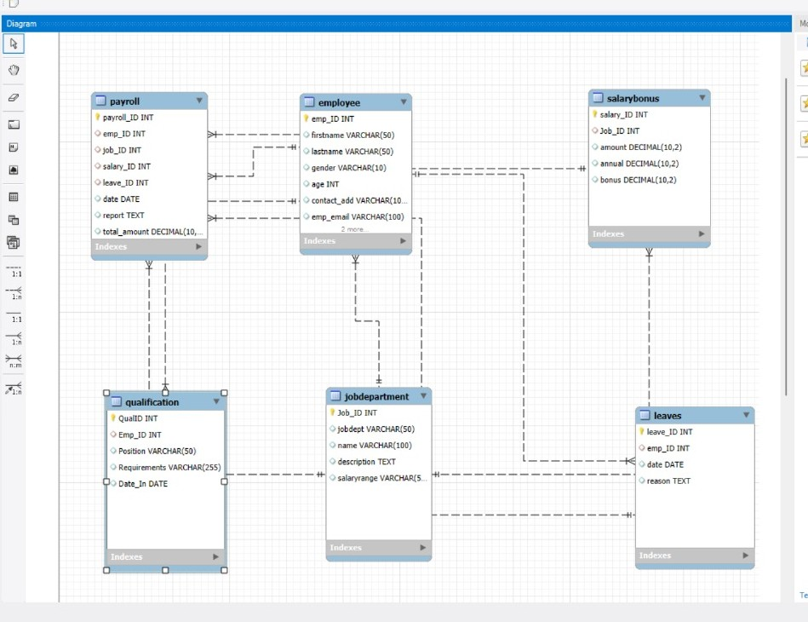
ENTITY RELATIONSHIP (ER) DIAGRAM

Slide 8
PROBLEM STATMENT
Manual/fragmented employee data management → errors & inefficiency
Difficulty in retrieving/updating employee records quickly
Payroll processing errors due to manual calculations
Lack of transparency in leave and job role management
No centralized system for tracking qualifications, salaries, and departmental roles
Data inconsistency without relational integrity (PKs, FKs, cascading updates)
Need for a robust Employee Management System (EMS) to:
Store & manage employee details securely
Automate payroll & leave tracking
Ensure data accuracy and consistency
Provide insights through queries & reports
Streamline HR operations and decision-making

Slide 9
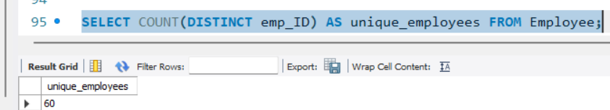
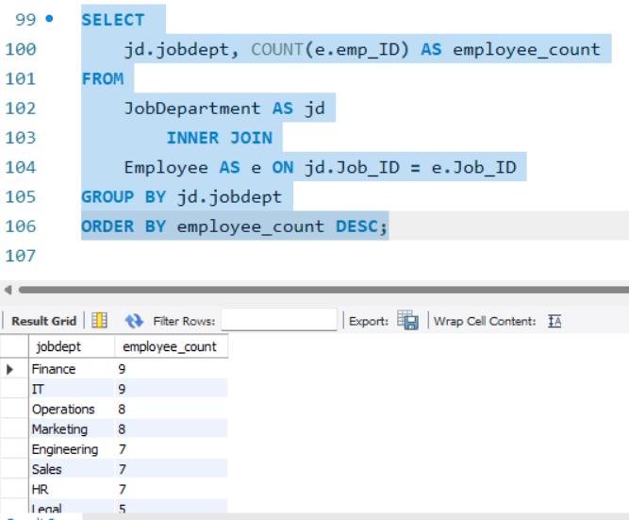
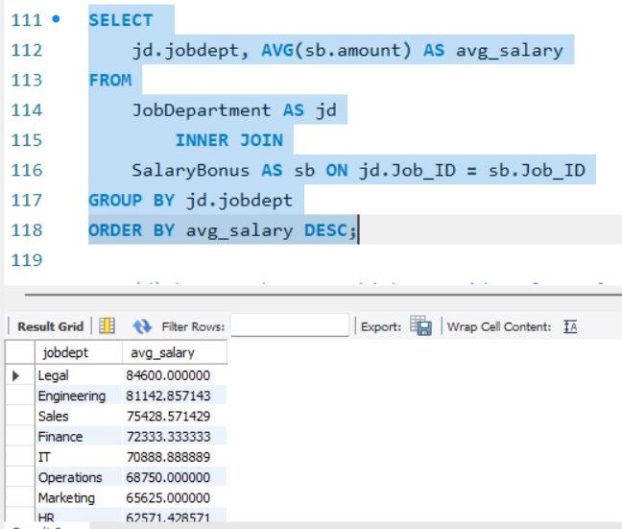
QUERIES:
1. EMPLOYEE INSIGHTS
1(b) Which departments have the highest number of employees?
1(a)How many unique employees are currently in the system?
1(c)What is the average salary per department?

Slide 10
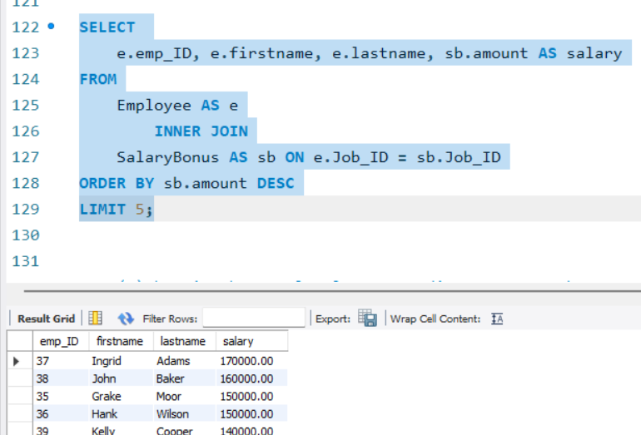
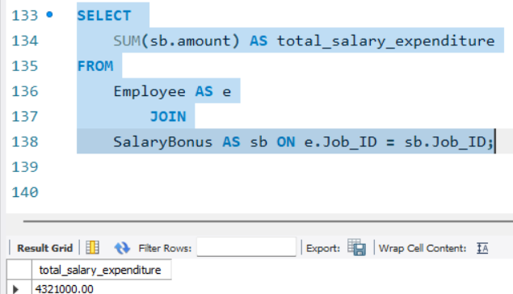
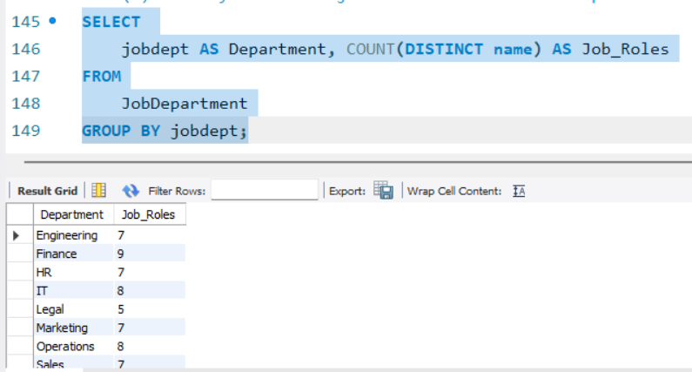
1(d)Who are the top 5 highest-paid employees?
1(e)What is the total salary expenditure across the company?
2. JOB ROLE AND DEPARTMENT ANALYSIS
2(a)How many different job roles exist in each department?

Slide 11
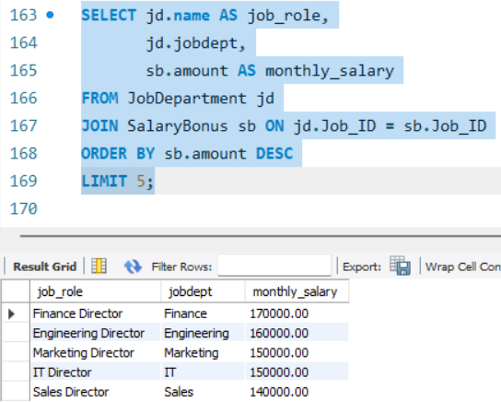
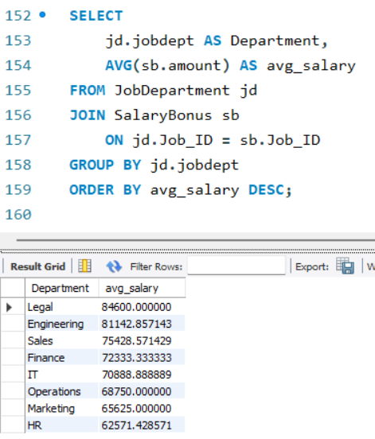
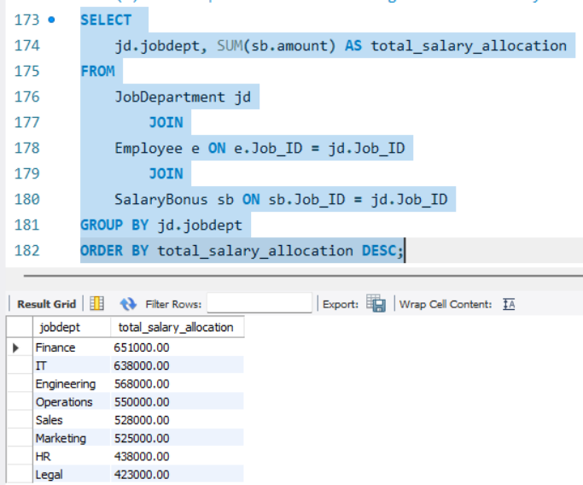
2(b)What is the average salary range per department?
2(c)Which job roles offer the highest salary?
2(d)Which departments have the highest total salary allocation?

Slide 12
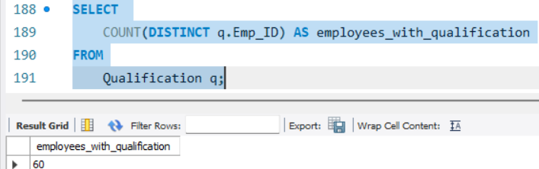
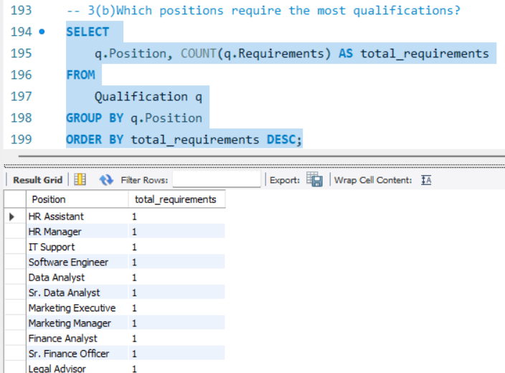
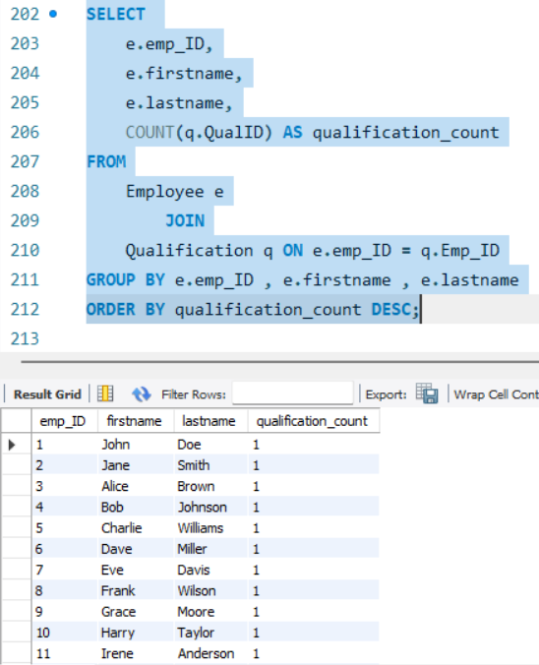
3. QUALIFICATION AND SKILLS ANALYSIS
3(b)Which positions require the most qualifications?
3(a)How many employees have at least one qualification listed?
3(c)Which employees have the highest number of qualifications?

Slide 13
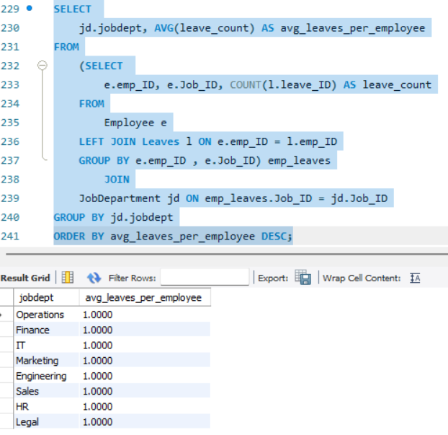
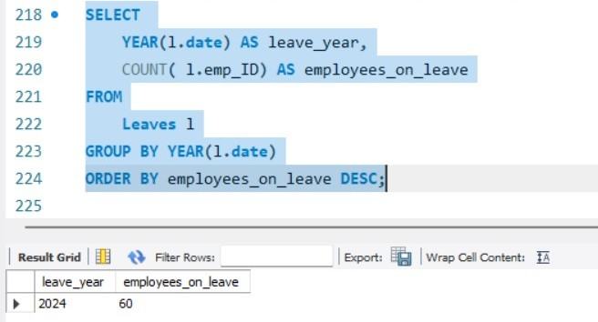
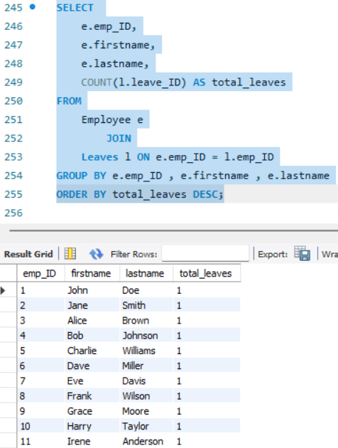
4. LEAVE AND ABSENCE PATTERNS
4(b)What is the average number of leave days taken by its employees per department?
4(a)Which year had the most employees taking leaves?
4(c)Which employees have taken the most leaves?

Slide 14
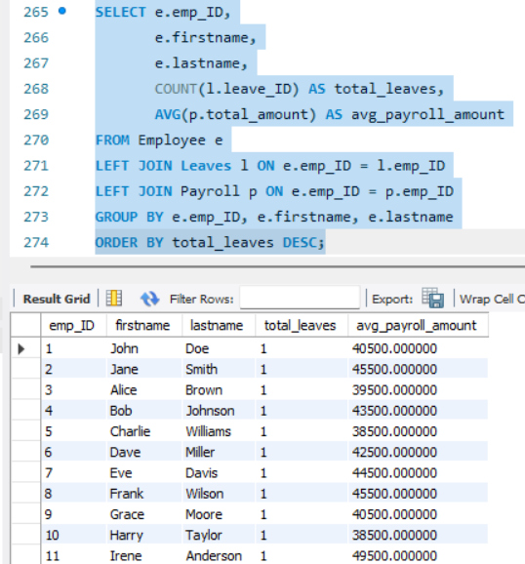
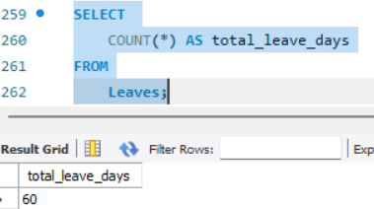
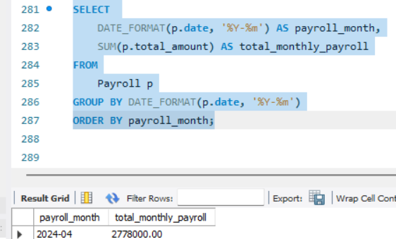
4(d)What is the total number of leave days taken company-wide?
4(e)How do leave days correlate with payroll amounts?
5.PAYROLL AND COMPENSATION ANALYSIS
5(a)What is the total monthly payroll processed?

Slide 15
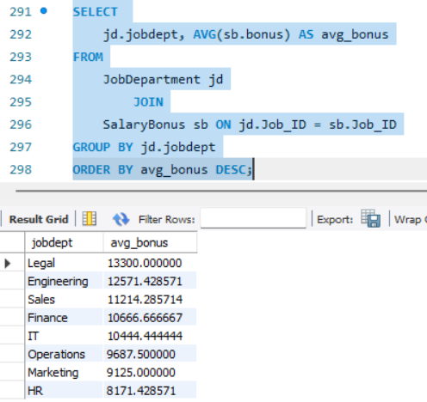
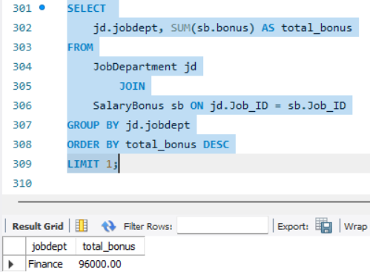
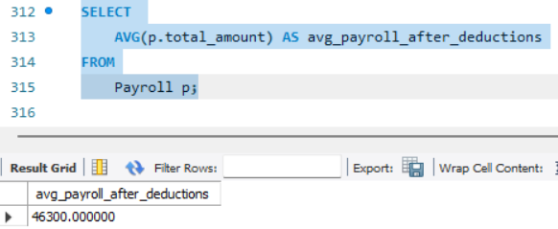
5(b) What is the average bonus given per department?
5(c) Which department receives the highest total bonuses?
5(d) What is the average value of total_amount after considering leave deductions?

Slide 16
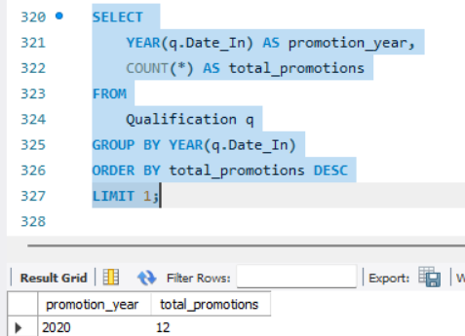
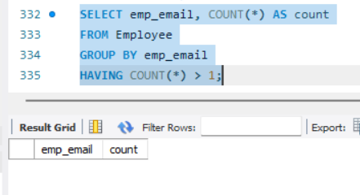
6. EMPLOYEE PERFORMANCE AND GROWTH
6(a)Which year had the highest number of employee promotions?
To check duplicates in the data

Slide 17
INSIGHTS:
Identifies which departments have the highest number of employees
Average salary per department and total salary expenditure reveal how budgets are allocated across roles.
Analysis shows which year had the most employees taking leaves and how leave days correlate with payroll amounts.
The system tracks promotions by year and shows which employees/positions have the highest number of qualifications

Slide 18
CHALLENGES:
Maintain relationship between tables with proper use of foreign keys so that we can perform operations
Write proper Sql joins for generating reports across employees, roles, leaves, and payroll.
Check any duplicates in the data

Slide 19

THANK YOU

